Slide 1



Joint Reversible Data Hiding and Homomorphic Encryption of Scalar Data
David Megías
Methodological Advancements in Information Hiding
Dagstuhl Research Meeting 25423
Schloss Dagstuhl, Wadern, Germany, October 15 – 17, 2025

Slide 2
Outline
Introduction
Proposal
Discussion

Slide 3
1 Introduction

Slide 4


1. Introduction
Data d_{k} at time t_{k}
IoT Sensor
Data Collector
Objective: data integrity + data provenance + confidentiality
Solution: combination of reversible watermarking and cryptography
Challenge: how to reversibly embed data (w_{k}) in a single data value (d_{k})?

Slide 5
1. Introduction
Classical solutions for reversible data hiding include:
Histogram shifting: requires many data
Difference expansion: requires at least two samples
Prediction error expansion: requires more than one sample
These options are not suitable when sensor readings are dispersed in time.

Slide 6
1. Introduction
Straightforward solution for reversible data hiding in d_{k} (data expansion):
d’_{k} ← 2d_{k} + w_{k}, w_{k} ∈ {0, 1} (for 1 bit)
d’_{k} ← qd_{k} + w_{k}, w_{k} ∈ {0, 1, 2, …, q–1} (for log₂(q) bits)
Limited capacity + Poor blending of data and watermark:
d_{k}
w_{k}
Challenge: “unlimited” capacity and better blending

Slide 7
2 Proposal

Slide 8
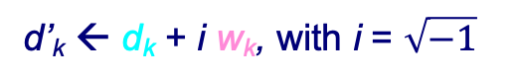
2. Proposal
Im(·)
d’_{k} ← q d_{k} + w_{k}
d’_{k} ← d_{k} + q w_{k}
w_{k}
d’_{k} ← d_{k} + i w_{k}, with i = $\sqrt{−1}$
w_{k}
w_{k}
d_{k}
w_{k}
Re(·)

Slide 9
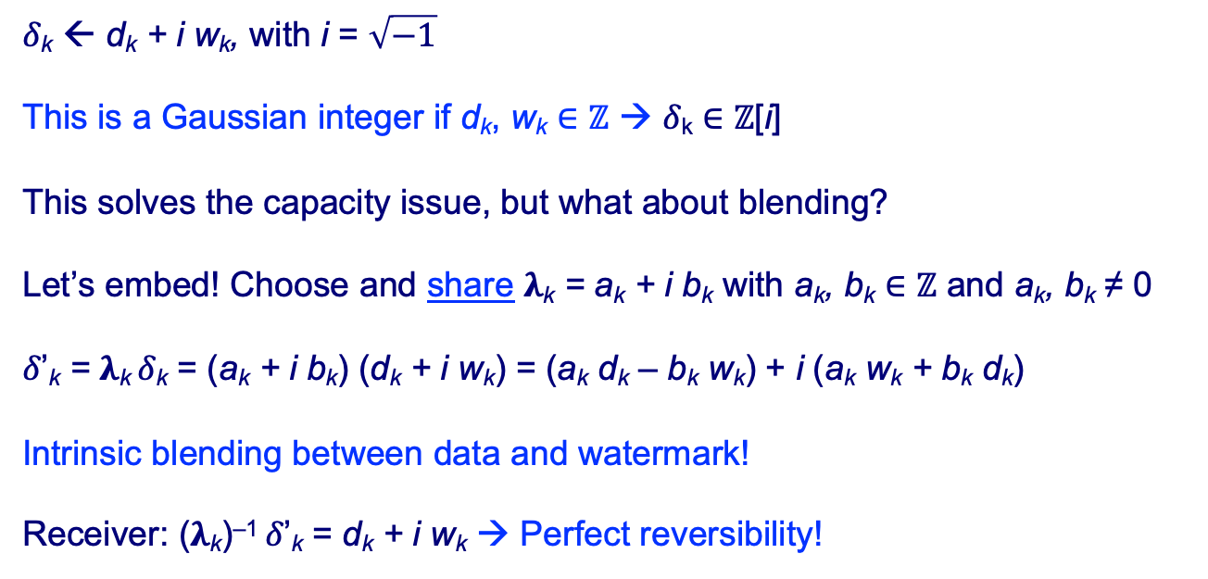
2. Proposal: Let’s go complex!
𝛿_{k} ← d_{k} + i w_{k}, with i = $\sqrt{−1}$
This is a Gaussian integer if d_{k}, w_{k} ∈ ℤ → 𝛿_{k} ∈ ℤ[i]
This solves the capacity issue, but what about blending?
Let’s embed! Choose and share 𝛌_{k} = a_{k} + i b_{k} with a_{k}, b_{k} ∈ ℤ and a_{k}, b_{k} ≠ 0
𝛿’_{k} = 𝛌_{k} 𝛿_{k} = (a_{k} + i b_{k}) (d_{k} + i w_{k}) = (a_{k} d_{k} – b_{k} w_{k}) + i (a_{k} w_{k} + b_{k} d_{k})
Intrinsic blending between data and watermark!
Receiver: (𝛌_{k})^{–1} 𝛿’_{k} = d_{k} + i w_{k} → Perfect reversibility!

Slide 10
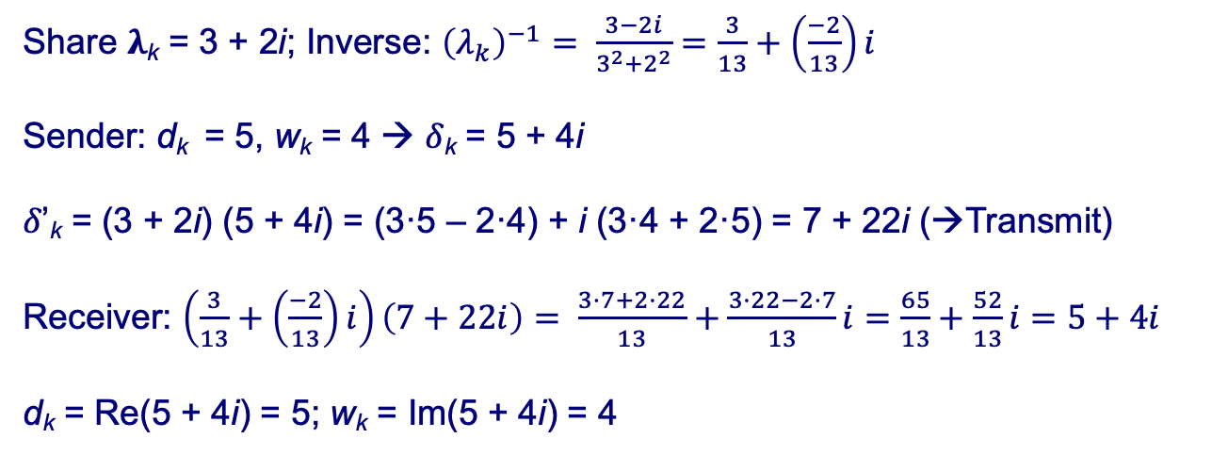
2. Proposal – Numerical example
Share 𝛌_{k} = 3 + 2i; Inverse: ${\left(λ_{k}\right)}^{−1}= \frac{3−2i}{3^{2}+2^{2}}=\frac{3}{13}+\left(\frac{−2}{13}\right)i$
Sender: d_{k} = 5, w_{k} = 4 → 𝛿_{k} = 5 + 4i
𝛿’_{k} = (3 + 2i) (5 + 4i) = (3·5 – 2·4) + i (3·4 + 2·5) = 7 + 22i (→Transmit)
Receiver: $\left(\frac{3}{13}+\left(\frac{−2}{13}\right)i\right)\left(7+22i\right)= \frac{3·7+2·22}{13}+\frac{3·22−2·7}{13}i=\frac{65}{13}+\frac{52}{13}i=5+4i$
d_{k} = Re(5 + 4i) = 5; w_{k} = Im(5 + 4i) = 4

Slide 11
2. Proposal: Confidentiality → Encryption
Transmit 𝛌_{k} encrypted from DC to S; Transmit 𝛿’_{k} = 𝛌_{k} 𝛿_{k} encrypted from S to DC
Can we do it jointly? Well, if we could multiply in the encrypted domain…
But we have ElGamal encryption… Don’t we?
Yes, but it works with a multiplicative cyclic group in ℤ…
OK, let’s make it work in ℤ[i] 😀

Slide 12
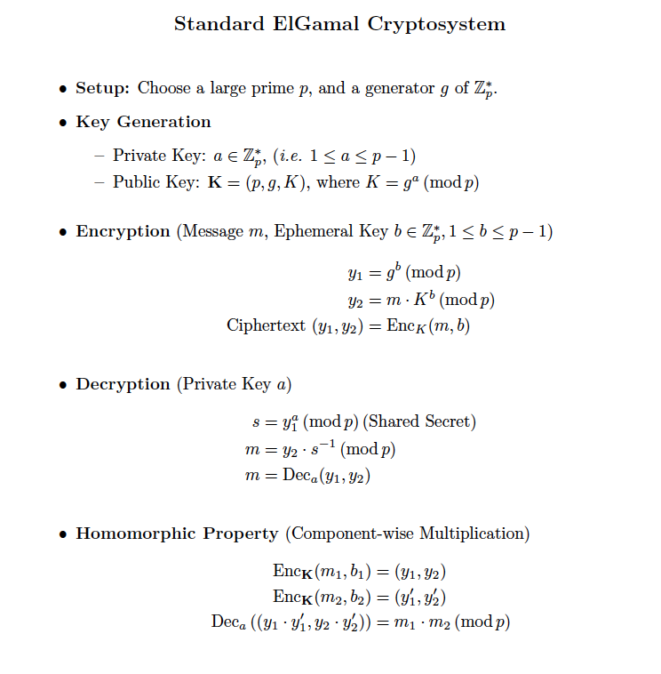
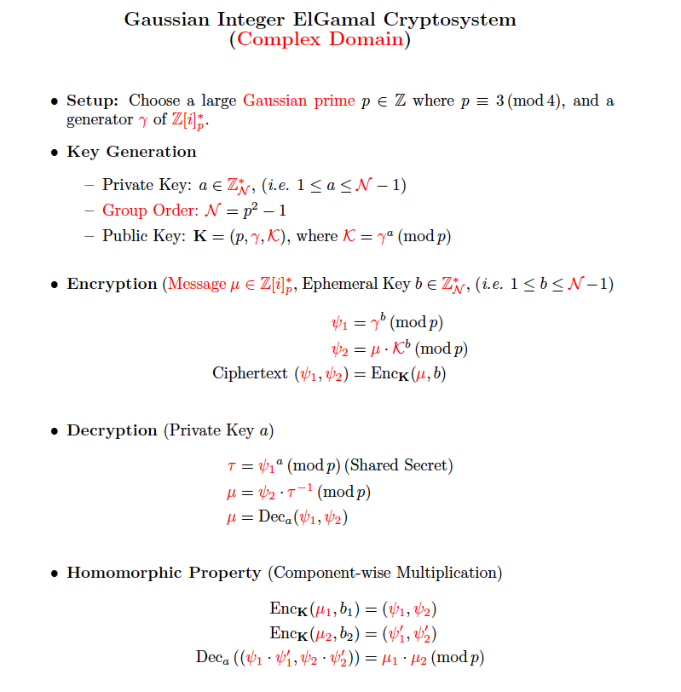
2. Proposal: Confidentiality → Encryption

Slide 13
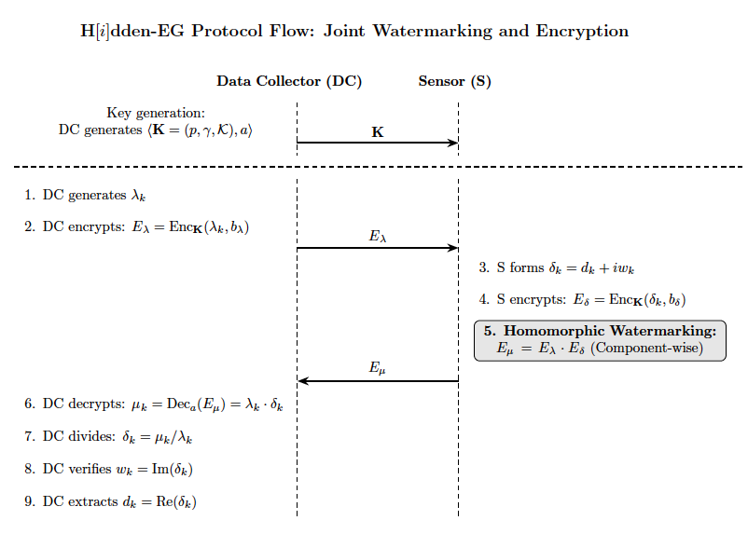
2. Proposal: Final protocol

Slide 14
3 Discussion

Slide 15


3. Discussion: Do you want to know more?
A preprint is available in arXiv.org: https://arxiv.org/abs/2510.03770
The Gaussian RDH scheme also supports data aggregation from different sources (sensors).
It can also be combined with an additive homomorphic cryptosystem, e.g., Paillier, to provide data aggregation in the encrypted domain.
The application of an additive homomorphism is straightforward, since the real and the imaginary parts can be added separately.
Neither either Paillier or ElGamal are quantum-resistant: there’s work to do!
Preprint
Python code

Slide 16

Thank you!!! 😁
Any questions?

